Slide 1
Track: Computer Vision
Team name: I_See_Hack
Team Members:
Gurjot Kaur
Gurojaspreet Kaur
Palak Kaushik

Slide 2
Problem Statement
The Driver Drowsiness and Uneasiness Detection System is designed to enhance road safety by using Computer Vision to alert drivers when they show signs of:
drowsiness,
uneasiness,
lethargy
or in case of severe medical emergencies like stroke, etc.
The objective is to develop a fully functional prototype that can help save lives and drastically reduce road instances happening due to driver drowsiness and lethargy.

Slide 3
Idea Overview
This is done using dlib that uses pre-trained facial landmark detectors to estimate the location of 68 coordinates that map facial structures to draw predictions.
Beeping noise is produced to alert the driver if he/she is found to be drowsy or inactive for more than 3 seconds.
A switch is provided that is to be turned off manually to stop the beep alert signal.
In case of a medical condition, for example stroke, and the driver becomes unconscious:
The beeping of signal continues
Emergency help signal is sent to ambulance and other rescuing teams.
The tail lights of car turns on
The car’s honking systems starts beeping to alert surrounding drivers.

Slide 4
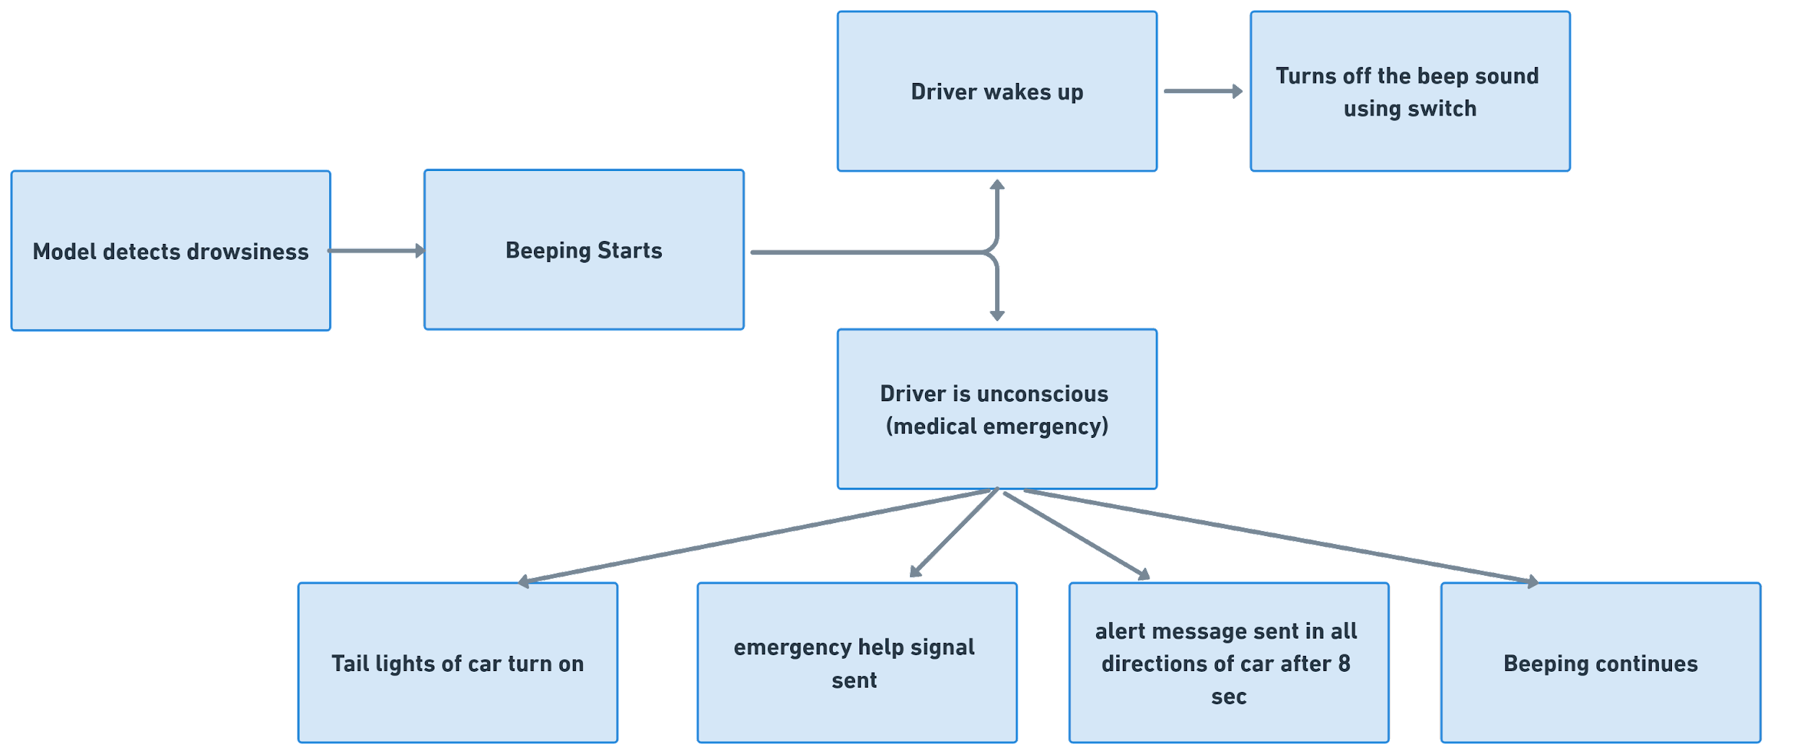
Idea Overview

Slide 5
Technical overview
Dlib: Known for its robust facial landmarks detection and shape prediction capabilities is used to make predictions.
Alarm System: We intend to alert surrounding cars in case the driver is asleep and not responding. We have integrated the car’s honking system with the microprocessor to beep incase of such an emergency, and turning the parking lights on to alert the drivers around them.
Emergency help signal: Sends an SMS with GPS coordinates to authorities or emergency lines in case the driver is not responding to the beep alarm. This is to ensure quick response for a potential accident. This can be done via multiple platforms, for our solution we have used Vonage.

Slide 6
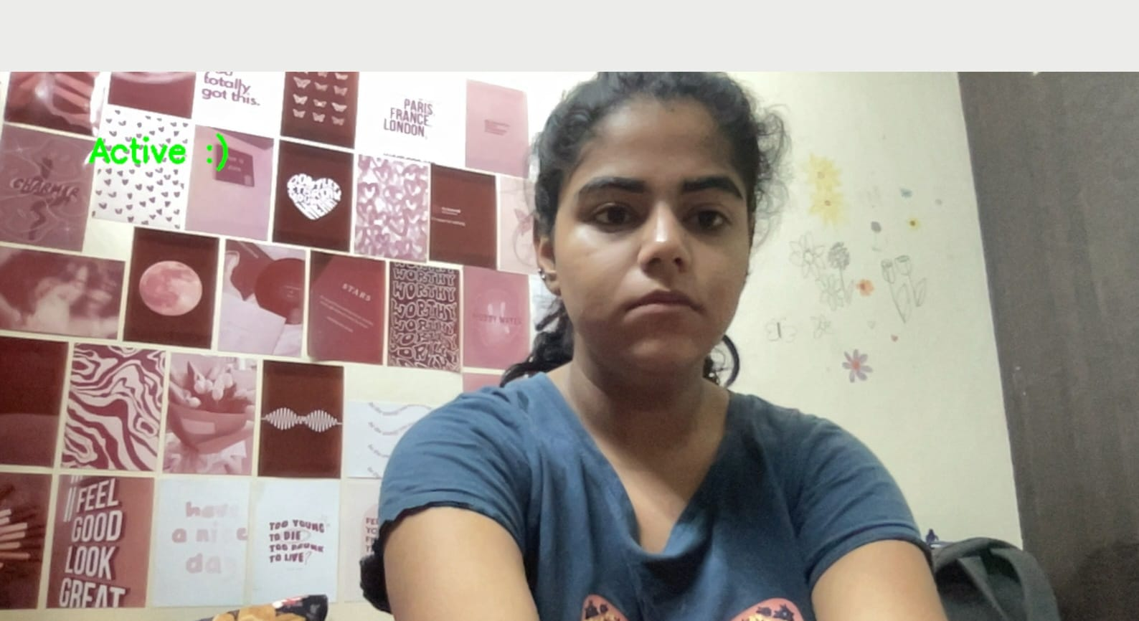
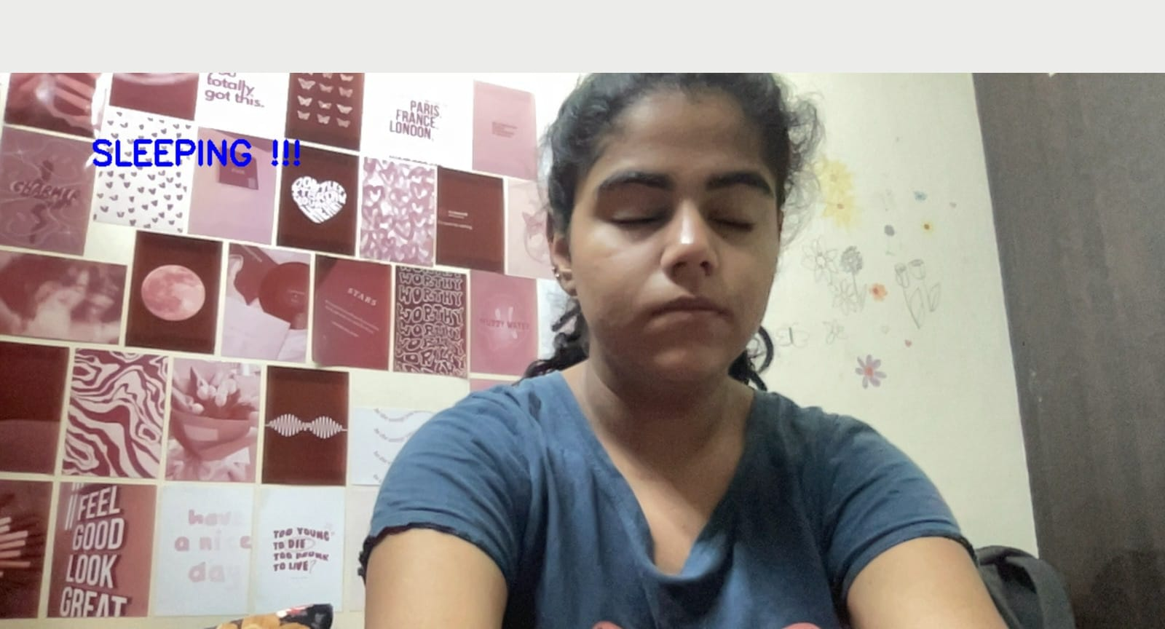
Execution/ model performance

Slide 7
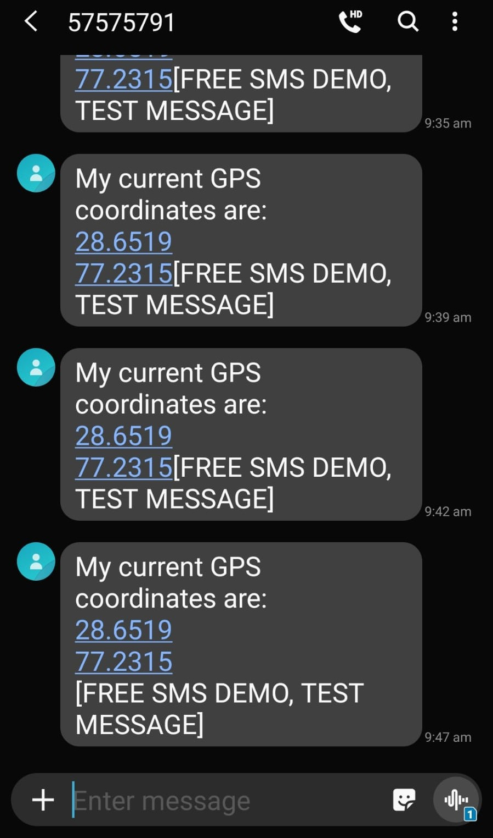
Execution
SMS sent to emergency lines including GPS coordinates for quick response in case of unconscious driver or potential accident site.

Slide 8
Future Scope
Implementation can be done using a kernel level thread.
This will increase the processing speed drastically which will be helpful to prevent life-threatening situations.
It will result in a faster and more efficient deployment of the algorithm, reduce processing power required and the time taken to analyse the data.

